Slide 1


Faith of our fathers, living still
History of Christianity
With Fr Jonathan Morse, Ph.D

Slide 2
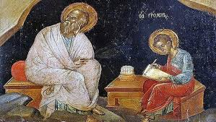
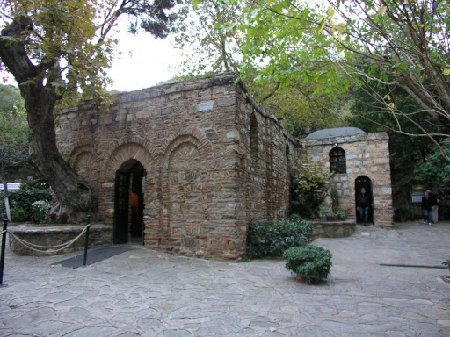
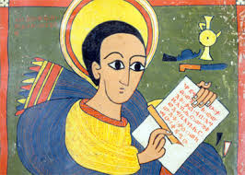

Faith of our fathers, living still
History of the Church
Episode 5: Sources of Expansion
John and Ephesus

Slide 3
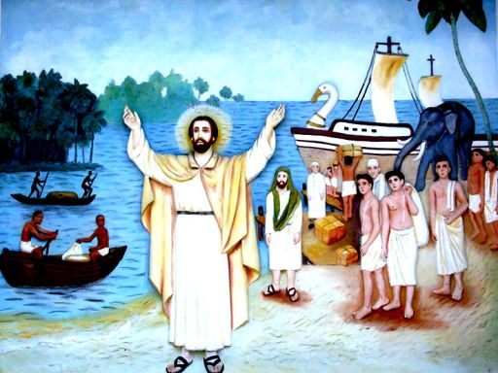
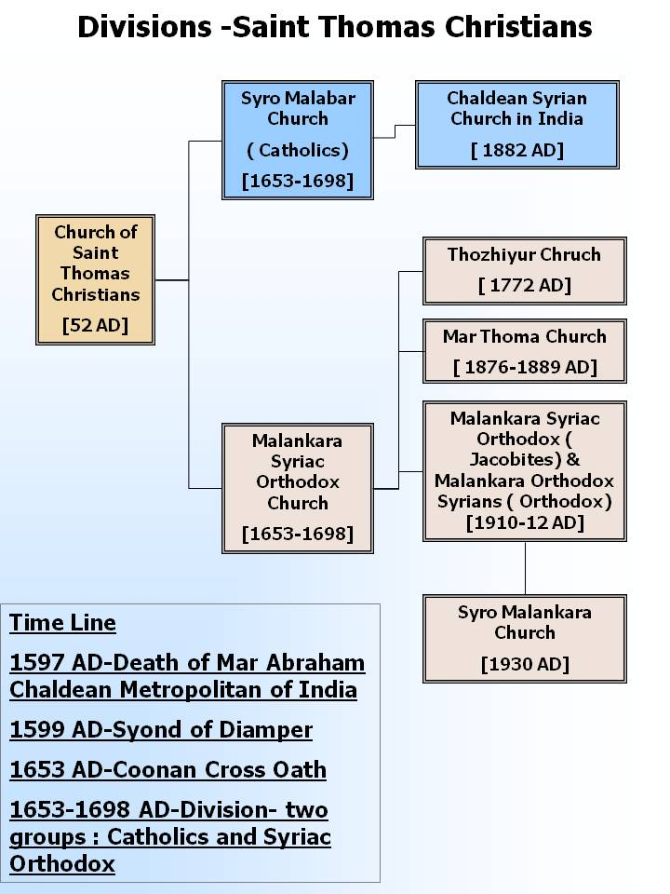
Faith of our fathers, living still
History of the Church
Episode 5: Sources of Expansion
Church in Syria
and St Thomas

Slide 4
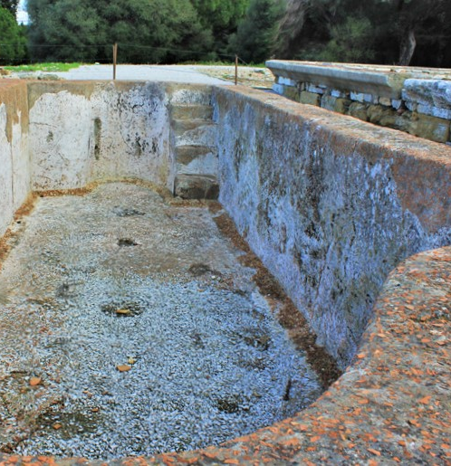
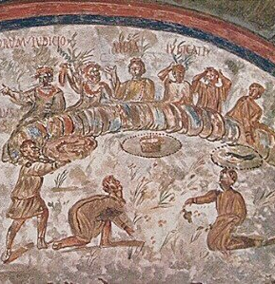
Faith of our fathers, living still
History of the Church
Episode 5: Sources of Expansion
Life in the time of the Apostles

Slide 5
Faith of our fathers, living still
Thank you for watching
Any questions address to Chaplain Morse
History of Christianity
Episode 5

