Slide 1
Faith of our fathers, living still
History of Catholicism
With Fr Jonathan Morse, Ph.D

Slide 2
Faith of our fathers, living still
Why We Study the Fathers
Did Jesus Really Exist?
History of Catholicism
Episode 2

Slide 3
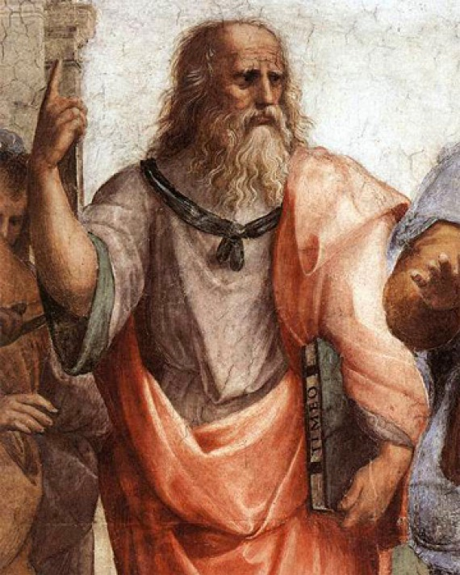
Faith of our fathers, living still
History of Catholicism
Episode 2

Slide 4
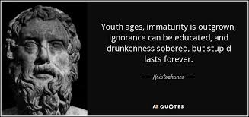
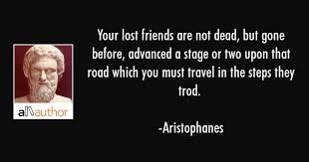
Faith of our fathers, living still
History of Catholicism
Episode 2

Slide 5
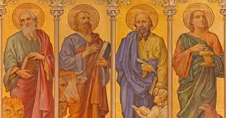
Faith of our fathers, living still
History of Catholicism
Episode 2

Slide 6
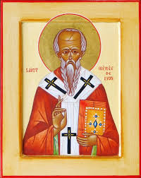
Faith of our fathers, living still
History of Catholicism
Episode 2

Slide 7
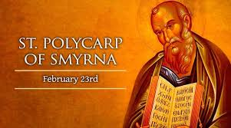
Faith of our fathers, living still
History of Catholicism
Episode 2

Slide 8
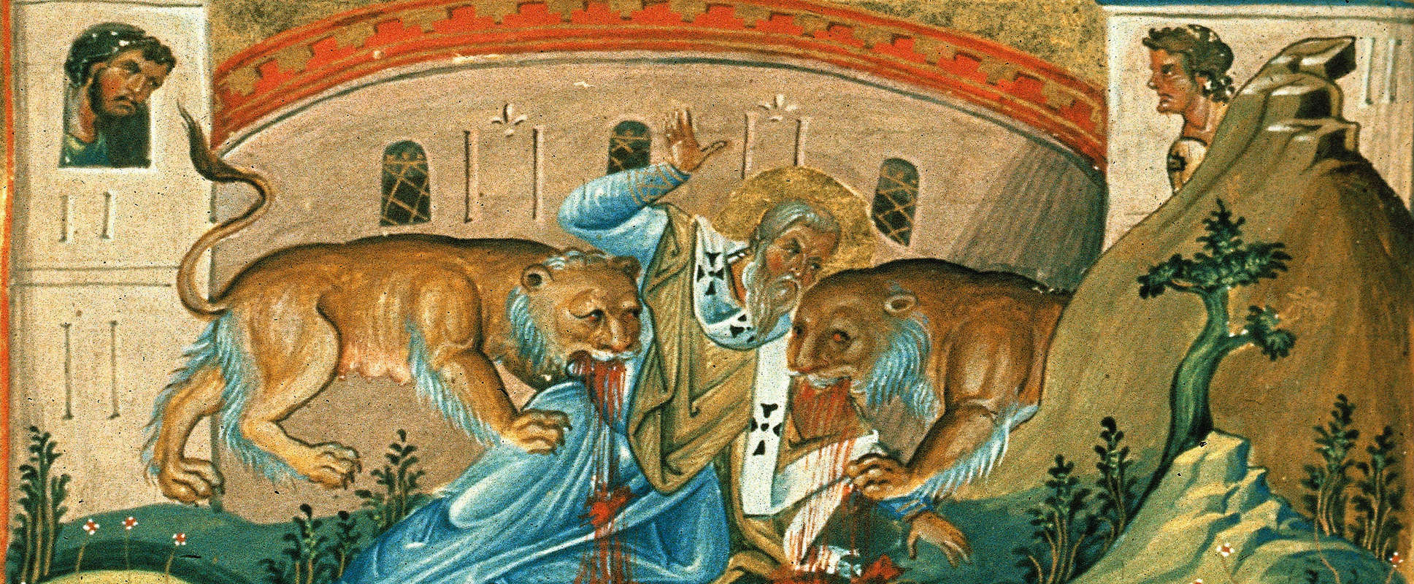
Faith of our fathers, living still
History of Catholicism
Episode 2

Slide 9
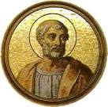
Faith of our fathers, living still
History of Catholicism
Episode 2

Slide 10
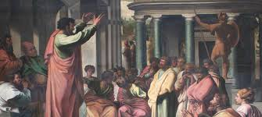
Faith of our fathers, living still
History of Catholicism
Episode 2

Slide 11
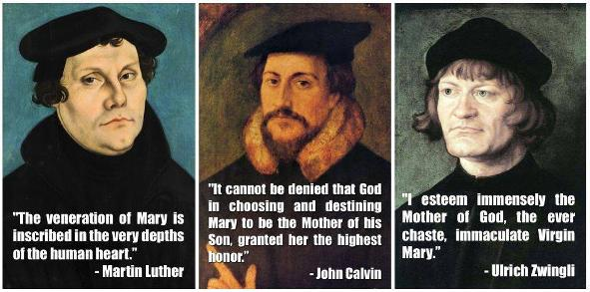
Faith of our fathers, living still
History of Catholicism
Episode 1 Jesus’ Family

Slide 12
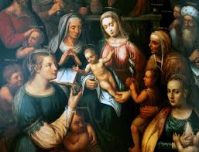
Faith of our fathers, living still
History of Catholicism
Episode 2 Jesus’ Family

Slide 13
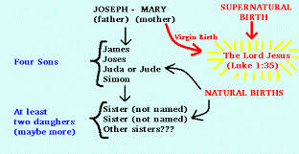
Faith of our fathers, living still
History of Catholicism
Episode 2 Jesus’ Family

Slide 14
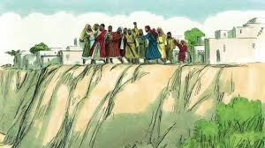
Faith of our fathers, living still
History of Catholicism
Episode 2 Jesus’ Family

Slide 15
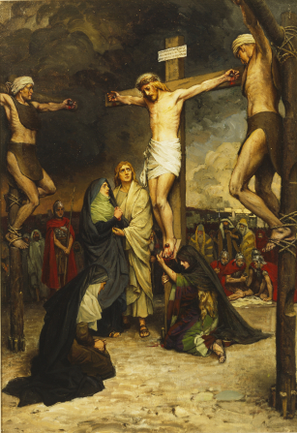
Faith of our fathers, living still
History of Catholicism
Episode 2 Jesus’ Family

Slide 16
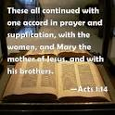
Faith of our fathers, living still
History of Catholicism
Episode 2 Jesus’ Family

Slide 17
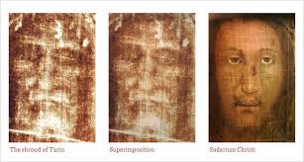
Faith of our fathers, living still
History of Catholicism
Episode 2 Jesus’ Family

Slide 18
Faith of our fathers, living still Thank you for watching Any questions address to Chaplain Morse
History of Catholicism
Episode 2

