Slide 1
Faith of our fathers, living still
History of Catholicism
With Fr Jonathan Morse, Ph.D

Slide 2
Faith of our fathers, living still
Faith of our Fathers! living still In spite of dungeon, fire, and sword: Oh, how our hearts beat high with joy Whene'er we hear that glorious word. Faith of our Fathers! Holy Faith! We will be true to thee till death.
History of Catholicism
Episode 1

Slide 3
Faith of our fathers, living still
Our Fathers, chained in prisons dark, Were still in heart and conscience free: How sweet would be their children's fate, If they, like them, could die for thee! Faith of our Fathers! Holy Faith! We will be true to thee till death.
History of Catholicism
Episode 1

Slide 4
Faith of our fathers, living still
Faith of our Fathers! Mary's prayers Shall win our country back to thee: And through the truth that comes from God England shall then indeed be free. Faith of our Fathers! Holy Faith! We will be true to thee till death.
History of Catholicism
Episode 1

Slide 5
Faith of our fathers, living still
Faith of our Fathers! we will love Both friend and foe in all our strife: And preach thee too, as love knows how By kindly words and virtuous life: Faith of our Fathers! Holy Faith! We will be true to thee till death.
History of Catholicism
Episode 1

Slide 6
Faith of our fathers, living still
History of Catholicism
Episode 1 Pentecost

Slide 7
Faith of our fathers, living still
History of Catholicism
Episode 1 Pentecost

Slide 8
Faith of our fathers, living still
History of Catholicism
Episode 1 Pentecost

Slide 9
Faith of our fathers, living still
History of Catholicism
Episode 1 Pentecost

Slide 10
Faith of our fathers, living still
History of Catholicism
Episode 1 Pentecost

Slide 11
Faith of our fathers, living still
History of Catholicism
Episode 1 Pentecost

Slide 12
Faith of our fathers, living still
History of Catholicism
Episode 1 Pentecost

Slide 13
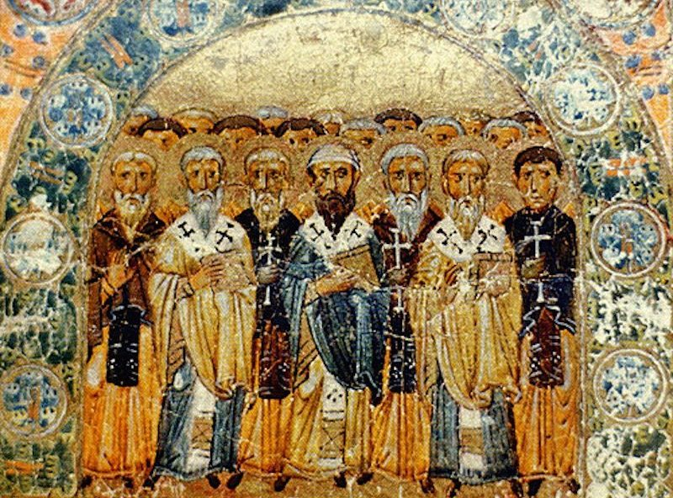
Faith of our fathers, living still
Why Should we study?
Undesrtand the New Testament Better
St Ignatius of ntioch
What is a Church Father?
What is the criteria to be a Father?
History of Catholicism
Episode 1 Church Fathers Why

Slide 14
Faith of our fathers, living still
St Ignatius of Antioch
History of Catholicism
Episode 1 Church Fathers Why

Slide 15
Faith of our fathers, living still
History of Catholicism
Episode 1 Church Fathers Why

Slide 16
Faith of our fathers, living still
History of Catholicism
Episode 1 Church Fathers Why

Slide 17
Faith of our fathers, living still Thank you for watching Any questions address to Chaplain Morse
History of Catholicism
Episode 1 Church Fathers Why

